Slide 1
FIRE FIGHTING ROBOT
Presented By:
Hazem Medhat, Yassin Mohamed, Eyad Emad, Janna Yasser, Menna tullah Khaled, Jana Hassan

Slide 2
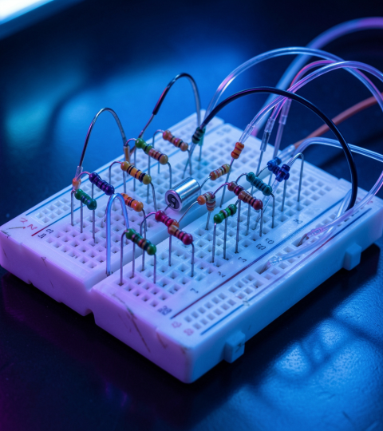
Contents
Fire Fighting Robot
K-Map
Boolean Expression
Circuit Design
The Truth Table
Truth Table Of The Water Pump
Code Of The Robot
Its Components
The Simulator (Circuit Design)

Slide 3
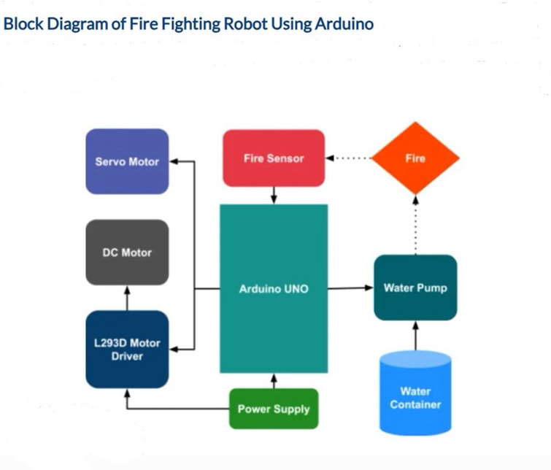

1. FIRE FIGHTING ROBOT
A fire-fighting robot uses flame sensors and digital logic components to detect fire, with an Arduino Uno serving as the main controller to process signals and control the robot’s response.

Slide 4
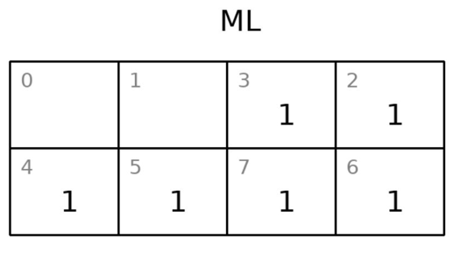
2. K-MAP
• F( R, F, L)= ⅀m(2,3,4,5,6,7)

Slide 5
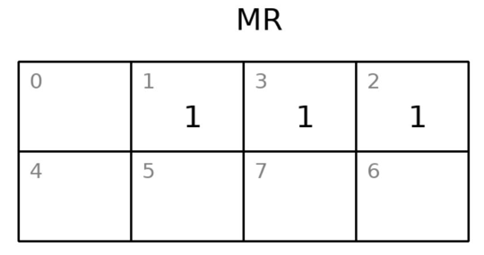
2. K-MAP
• F( R, F, L)= ⅀m(1,2,3)

Slide 6
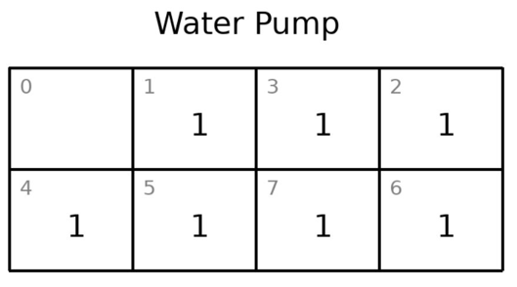
2. K-MAP
F( R, F, L)= ⅀m(1,2,3,4,5,6,7)

Slide 7

3. Boolean Expression
The system follows a priority-based logic where the right sensor dominates over front and left sensors, which is reflected in the Boolean expressions.

Slide 8
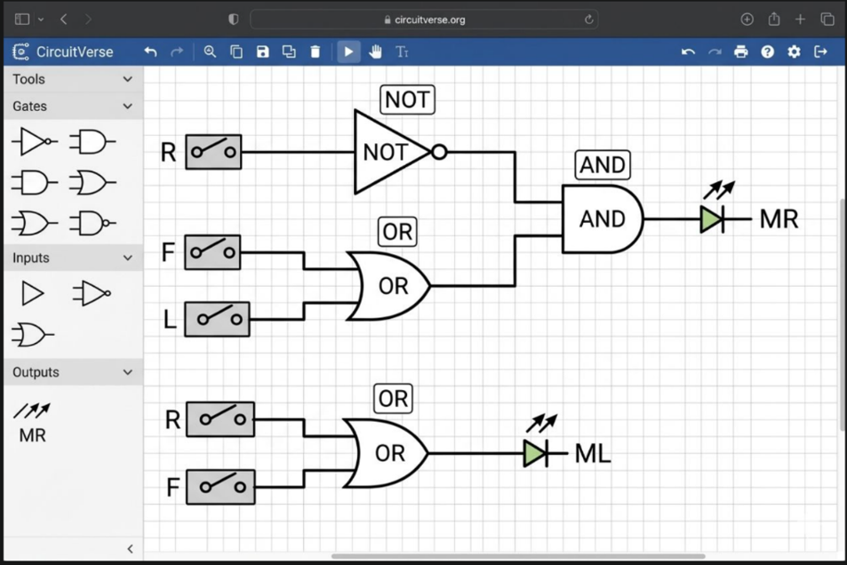
4. Circuit Design
The circuit uses basic digital logic gates: 1.NOT
2.OR
3.AND
to process signals from three fire sensors: 1.Right (R)
2.Front (F)
3.Left (L).
Using the Boolean expressions ML = R + F and MR = R'(F + L)
it controls the robot’s motors to move toward the fire source. The design gives priority to the right sensor, helping the robot turn or move correctly depending on where the fire is detected.

Slide 9

5. The Truth Table
• R, F and L are the inputs ML and MR the outputs.
As an Input:
The system uses three input sensors:
1.Right
2.Front
3.Left — to control the robot’s movement through combinational logic.
As an Outputs:
ML and MR, are simplified motor control signals derived from the Arduino code and determine the operation of the left and right motors.

Slide 10
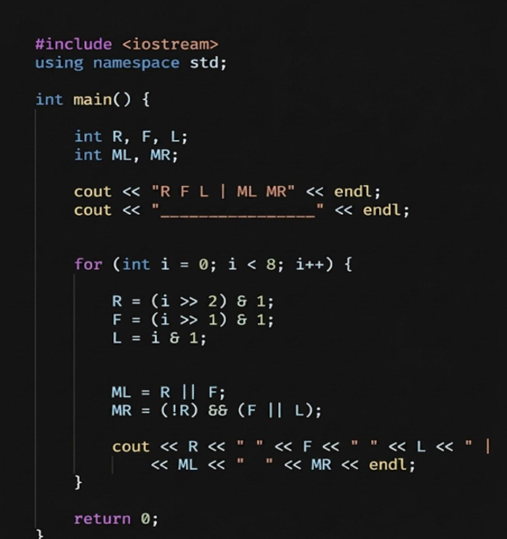
5. The Truth Table
Code of the truth table:

Slide 11
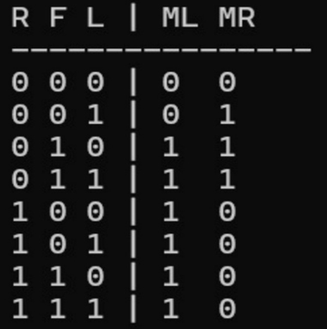
5. The Truth Table
Its output:

Slide 12

6. Truth Table of the water pump
The table represents a 3-input OR logic gate (L + F + R), where the pump activates when any sensor outputs a signal (1) and turns off only when all sensors are inactive (0).

Slide 13
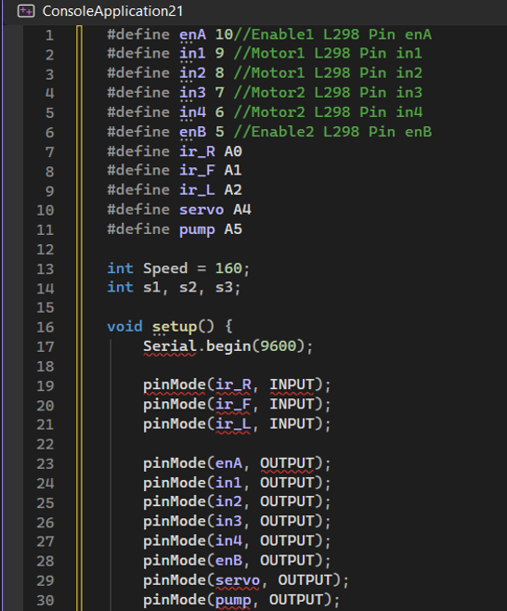
7. Code of the Robot

Slide 14
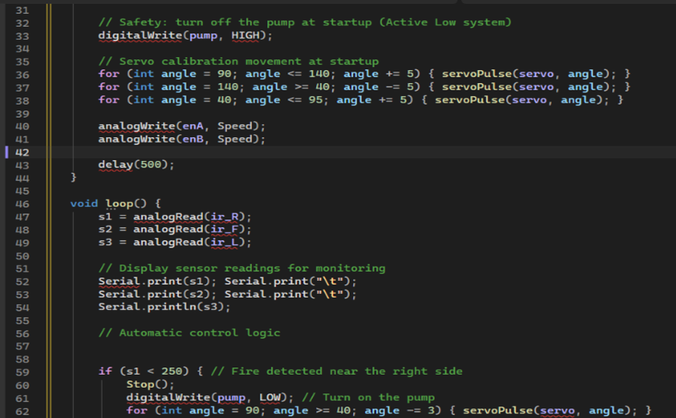
7. Code of the Robot

Slide 15
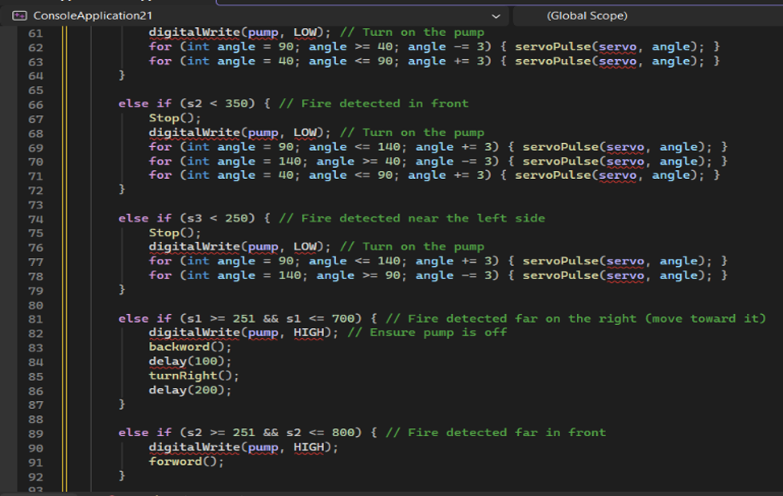
7. Code of the Robot

Slide 16
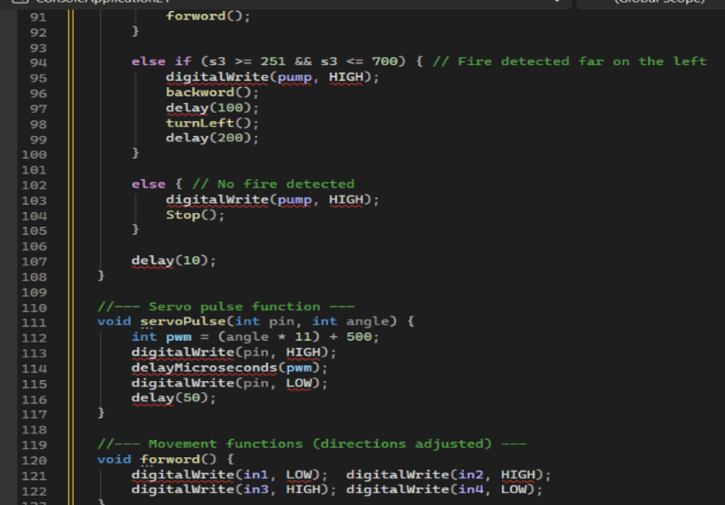
7. Code of the Robot

Slide 17
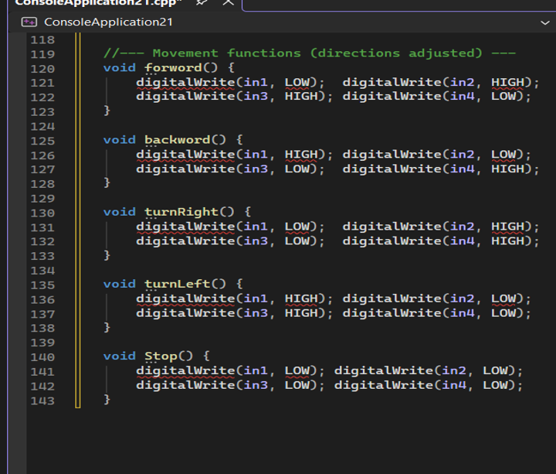
7. Code of the Robot

Slide 18
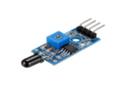

8. Its components
1-Flame Sensor 4 Pin
2- DC Geared Motor with wheel
A DC gear motor converts electrical energy into rotational motion, using a built-in gearbox to reduce speed and increase torque for driving wheels or moving platforms.
Detects fire by sensing infrared light from flames and is commonly used in fire alarms and firefighting robots.

Slide 19
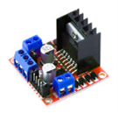
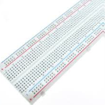
8. Its components
3-Motor Driver Module (L298N)
4-Breadboard
Acts as an interface between a microcontroller and motors, allowing speed and direction control through low-power signals.
A solderless prototyping board used to build and test circuits with easy, reusable wiring through internally connected rows and columns.

Slide 20
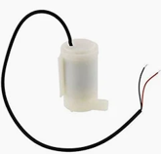
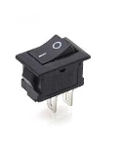
8. Its components
6-ON/OFF Black Switch 2Pins
KCD1-11
Dim:14*9mm
5-Submersible Water Pump
A submerged pump used to move water, commonly applied in irrigation systems, aquariums, and firefighting robots for spraying water when fire is detected.
A basic switch used to connect or disconnect power in a circuit, often acting as the main power control for a device or project.

Slide 21
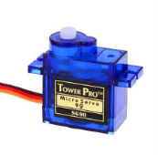
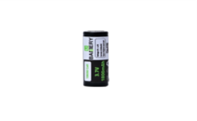
8. Its components
18650Battery Cell
(USED) -
1800mAh
8-Servo SG90
180°
A rechargeable portable power source that supplies energy to all components, including the motors, pump, and microcontroller, enabling the robot to operate wirelessly and move freely.
A motor that rotates between 0–180° to precisely position components; in a firefighting robot, it directs the water pump nozzle toward the detected flame.

Slide 22
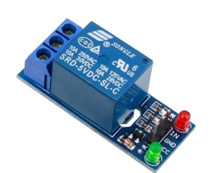
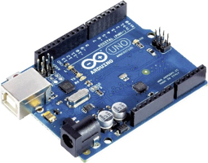
8. Its components
9-Relay one Chanel
10-Arduino Uno
An electrically controlled switch that allows a microcontroller to safely control high-power devices like a water pump using low-power signals while isolating the control and power circuits.
The main controller of the project that processes sensor and button inputs, executes programmed instructions, and controls outputs like motors, LEDs, and pumps. It is open-source and beginner-friendly.

Slide 23
9. The Simulator(circuit design)
The system is built around an Arduino Uno, which acts as the main controller.
It receives input from three flame sensors to detect fire direction.
The L298 motor driver controls four DC geared motors to move the robot toward the fire.
A servo motor adjusts the water nozzle to aim at the fire.
A relay module turns on the submersible pump to spray water through a tube.
The system is powered by two 18650 batteries with an ON/OFF switch for control.
Overall, it combines sensing, movement, and fire extinguishing in one integrated system.

Slide 24
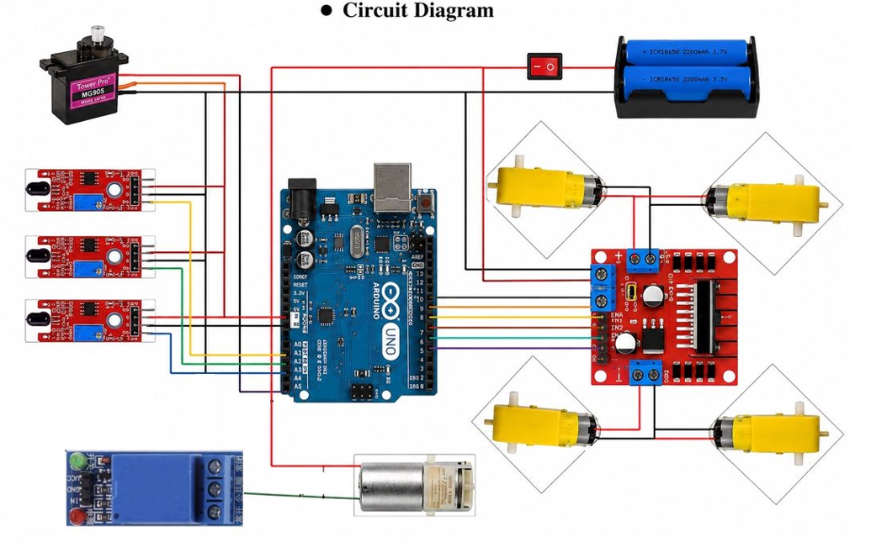
9. The Simulator(circuit design)

Slide 25

THANK YOU!

